Slide 1
Linear Model Selection and Regularization

Slide 2
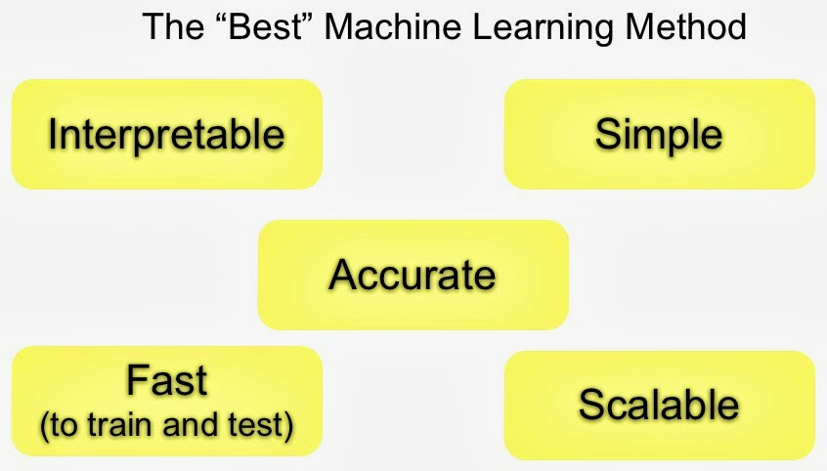

Slide 3
Recall: Linear Modelling
Recall the simple linear model
Y = β0 + β1X1 + · · · + βpXp + e
Despite its simplicity, the linear model has distinct advantages in terms of its interpretability and often shows good predictive performance.
The simple linear model uses, by default, Ordinary Least Squares fitting.

Slide 4
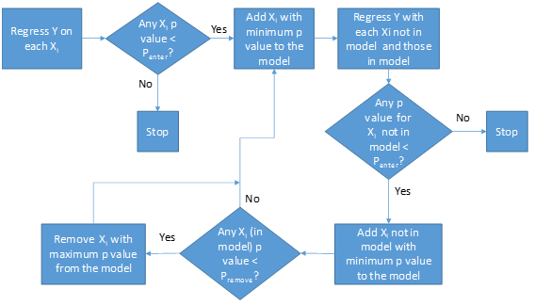
Simple Linear Regression

Slide 5
Ordinary Least Squares
In statistics, Ordinary Least Squares is a method for estimating the unknown parameters in a Linear Regression model, with the goal of minimizing the sum of the squares of the differences between the observed responses (values of the variable being predicted) in the given dataset and those predicted by a linear function of a set of explanatory variables.
Visually this is seen as the sum of the squared vertical distances between each data point in the set and the corresponding point on the regression line – the smaller the differences, the better the model fits the data.

Slide 6
Why consider alternatives to least squares?
Prediction Accuracy:
Provided that the true relationship between the response and the predictors is approximately linear, the least squares estimates will have low bias.
If n >> p, then the least squares estimates tend to also have low variance, and hence will perform well on test observations.
If n > p, then there can be a lot of variability in the least squares fit, resulting in overfitting and consequently poor predictions on future observations not used in model training.
If n < p, then there is no longer a unique least squares coefficient estimate: the variance is infinite so least square method cannot be used at all.
By constraining or shrinking the estimated coefficients, we can often substantially reduce the variance at the cost of a negligible increase in bias.

Slide 7
Model Interpretability:
Including irrelevant variables leads to unnecessary complexity in the resulting model.
By removing irrelevant variables—that is, by setting the corresponding coefficient estimates to zero—we can obtain a model that is more easily interpreted.
Ordinary least squares is extremely unlikely to yield any coefficient estimates that are exactly zero.

Slide 8
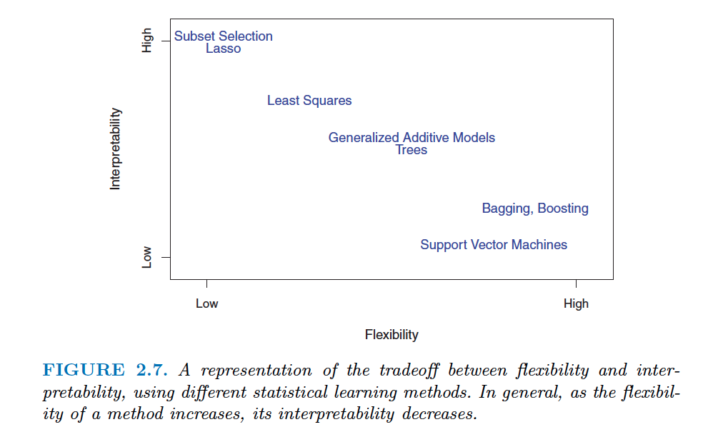

Slide 9
Improving from Linear Regression
Try other Regression models that do not use Ordinary Least Squares to compute error:
Logistic Regression
Polynomial Regression
Stepwise Regression
Ridge Regression
Lasso Regression
ElasticNet Regression

Slide 10
Alternatives to using Least Squares:
Subset Selection:
This approach involves identifying a subset of the p predictors that we believe to be related to the response.
Fit a model using least squares on the reduced set of variables.
Shrinkage:
Fit a model involving all p predictors, the estimated coefficients are then shrunken towards zero relative to the least squares estimates.
Shrinkage (or Regularization) reduces variance.
Depending on what type of shrinkage is performed, some of the coefficients may be estimated to be exactly zero. Hence, shrinkage methods can also perform variable selection.

Slide 11
Dimension Reduction:
This approach involves projecting the p predictors into a M-dimensional subspace, where M < p.
The p predictors are projected into the reduced subspace, followed by regression with least squares in order to generate a model.

Slide 12
Best Subset Selection
Let M₀ denote the null model, which contains no predictors.
For k = 1, 2,...p:
Fit all (^{p}_{k}) models that contain exactly k predictors.
Pick the best among these (^{p}_{k}) models, and call it M_{k}
Here best is defined as having the smallest RSS, or equivalently largest R²
Select a single best model from among M₀,...,M_{p} using cross validated prediction error, C_{p} (AIC), BIC, or adjusted R².

Slide 13
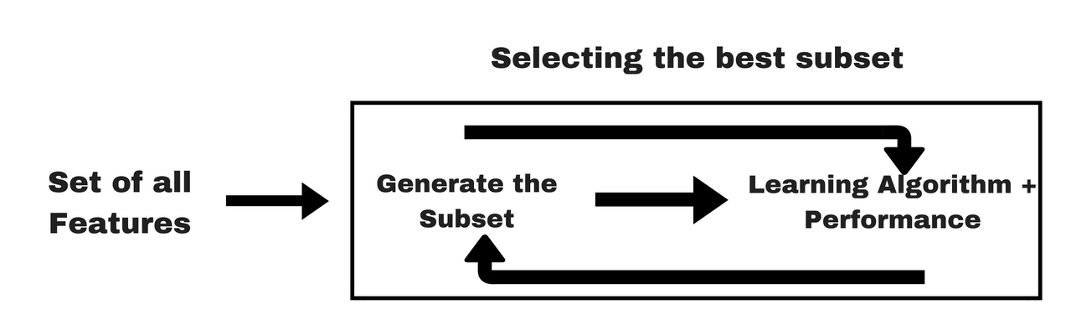

Slide 14
Forward Stepwise Selection
Let M₀ denote the null model, which contains no predictors.
For k = 1, 2,...p-1:
Consider all p – k models that augment the predictors in M_{k} with one additional predictor
Pick the best among these p – k models, and call it M_{k+1}
Here best is defined as having the smallest RSS, or equivalently largest R²
Select a single best model from among M₀,...,M_{p} using cross validated prediction error, C_{p} (AIC), BIC, or adjusted R².

Slide 15
Backward Stepwise Selection
Let M₀ denote the full model, which contains all p predictors.
For k = p, p-1, …, 1:
Consider all k models that contain all but one of the predictors in M_{k}, for a total of k - 1 predictors
Pick the best among these k models, and call it M_{k-1}
Here best is defined as having the smallest RSS, or equivalently largest R²
Select a single best model from among M₀,...,M_{p} using cross validated prediction error, C_{p} (AIC), BIC, or adjusted R².

Slide 16
Best Subset Selection
Forward Stepwise Selection / Backward Stepwise Selection
Selecting the best model from among the 2^{p} possibilities
Simple and conceptually appealing
End result is a number of models and their summary statistics
Not suitable for large number of predictors as the possibilities become exponential
Computationally expensive
Select the best among 1+p(p+ 1)/2 models
Complex steps, involves dropping variables at each iteration
End result is a simple model
Suited for large number of predictors
Computationally less expensive

Slide 17
Maximum Likelihood Estimate
Maximum Likelihood Estimation (MLE) is a technique to find the most likely function that explains observed data
Estimate the parameters of a statistical model given the observations, by finding the parameter values that maximize the likelihood/probability of making the observations given the parameters

Slide 18
Choosing the Optimal Model
Selection processes result in a creation of a set of models each of which contain a subset of the p different predictors
The best model can be selected by:
Estimating a test error on a validation set
Indirect estimation of test error by adjusting the training error to account for a bias due to over fitting
The optimality of a model can be assessed using the following parameters:
Mallows’ C_{p}
Akaike Information Criterion
Bayesian Information Criterion
Adjusted R²

Slide 19
Mallows' C_{p}
Used to assess the fit of a regression model, estimated using Ordinary Least Squares, in the context of model selection, where:
A number of predictor variables are available for predicting some outcome
Goal is to find the best model involving a subset of these predictors
Smaller value of C_{p} implies a relatively precise model
Addresses the issue of overfitting
In a model selection statistic such as Residual Sum of Squares:
RSS keeps reducing as more predictors are added to the model
The model with the smallest RSS is always the model including all the variables

Slide 20
The C_{p} Statistic calculated on a sample of data estimates the Mean Squared Prediction Error (MSPE) as its population target:
MSPE will not automatically get smaller as more variables are added. The optimum model under this criterion is a compromise influenced by the sample size, the effect sizes of the different predictors, and the degree of collinearity between them.
For p predictors, C_{p} is defined as:

Slide 21
Limitations and Usage of C_{p}
C_{p} approximation has two major disadvantages:
C_{p} approximation is only valid for large sample size
C_{p} cannot handle complex collections of models as in the variable selection (or feature selection) problem
Usage:
C_{p} statistic is often used as a stopping rule for various forms of stepwise regression
Under a model not suffering from appreciable lack of fit (bias), C_{p} has expectation nearly equal to p
In extreme cases, we can apply C_{p}<2p to adjust for the positive bias

Slide 22
Akaike Information Criterion
AIC is an estimator of the relative quality of statistical models for a given set of data
Given a collection of models for the data, AIC estimates the quality of each model, relative to each of the other models
AIC is founded on information theory:
It offers an estimate of the relative information lost when a given model is used to represent the process that generated the data
In doing so, it deals with the trade-off between the goodness of fit of the model and the complexity of the model

Slide 23
For a model of k estimated parameters and L being the maximum value of the likelihood function:
Preferred model is the one with least AIC value
AIC rewards goodness of fit as assessed by the likelihood function
AIC also includes a penalty to discourage overfitting

Slide 24
Bayesian Information Criterion
BIS is similar to AIC in the following aspects:
Criterion for model selection among a finite set of models
Models with the lowest BIC are preferred
Based on the Maximum Likelihood Function
Attempts to reduce overfitting by adding penalty terms
Although BIC and AIC aim to reduce overfitting using penalty terms, BIC adds a larger penalty than AIC
For a model of k estimated parameters and L being the maximum value of the likelihood function:

Slide 25
Properties of BIC:
BIC is independent of the prior or the prior is "vague" (a constant).
BIC can measure the efficiency of the parameterized model in terms of predicting the data.
BIC penalizes the complexity of the model where complexity refers to the number of parameters in the model.
Limitations of BIC:
Approximation is valid only for sample size n much larger than the number of parameters k in the model
BIC cannot handle complex collections of models as in the variable selection problem in higher-dimensions

Slide 26
Adjusted R²
The R² statistic automatically and spuriously increases when more predictors are taken into account
Adjusted R² attempts to reduce this effect
Adjusted R² can be negative, and its value will always be less than or equal to that of R²
Adjusted R² increases only when the increase in R² due to inclusion of a new predictor is more than one would expect to see by chance

Slide 27
Validation and Cross Validation
Test error can be directly estimated using Validation and Cross Validation approach
This process is a direct approach to estimate the test error
Cross validation is computationally expensive, hence only in cases where the dataset is large and has a large number of predictors would we opt for other methods of estimating the test error

Slide 28
Shrinkage Methods
Selection methods involve using ordinary least squares to fit a model to a subset of predictors
Shrinkage methods or Regularization aims to fit a model using all p predictors by constraining the coefficient estimates towards zero
Shrinkage reduces the variance of coefficient estimates significantly

Slide 29
Regularization
Regularization is the process of introducing additional information in order to solve an ill-posed problem or to prevent overfitting
L1 Regularization: Least Absolute Deviations
Minimizes the sum of the absolute differences between true value and predicted value
L2 Regularization: Least Squares Error
Minimizes the sum of square of the differences between true value and predicted value

Slide 30
Why Regularize
Analyzing multiple regression data that suffer from multicollinearity
Collinearity is the existence of near-linear relationships among independent variables
During regression collinearity causes a division by near-zero values, distorting the output
When multicollinearity occurs, least squares estimates are unbiased, but their variances are large so they may be far from the true value

Slide 31
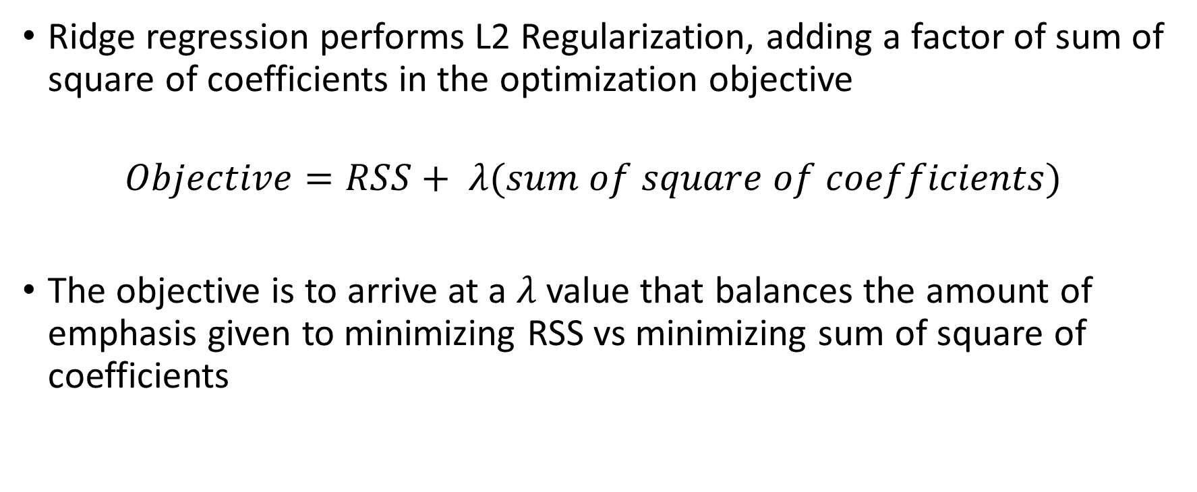
Ridge Regression
Ridge regression performs L2 Regularization, adding a factor of sum of square of coefficients in the optimization objective
$$Objective=RSS+ λ(sum of square of coefficients)$$
The objective is to arrive at a $λ$ value that balances the amount of emphasis given to minimizing RSS vs minimizing sum of square of coefficients

Slide 32
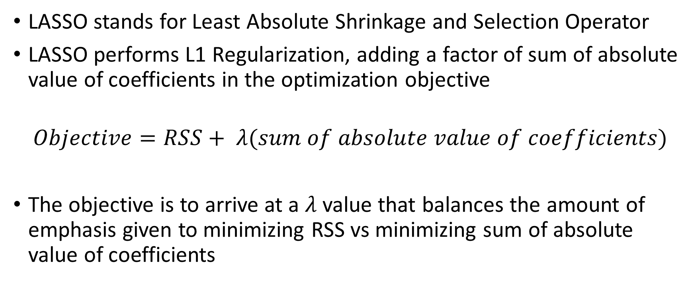
LASSO Regression
LASSO stands for Least Absolute Shrinkage and Selection Operator
LASSO performs L1 Regularization, adding a factor of sum of absolute value of coefficients in the optimization objective
$$Objective=RSS+ λ(sum of absolute value of coefficients)$$
The objective is to arrive at a $λ$ value that balances the amount of emphasis given to minimizing RSS vs minimizing sum of absolute value of coefficients

Slide 33
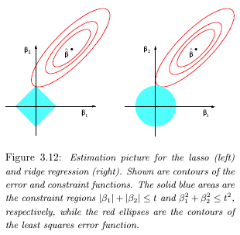
Ridge Regression vs LASSO Regression

Slide 34
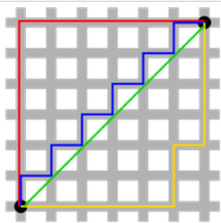
Ridge Regression
LASSO Regression
Non-sparse outputs
Computationally efficient
No feature selection
Complex models
Sparse outputs
Computationally inefficient on non-sparse inputs
In-built feature selection
Simpler models
The green line (Ridge regression) is the unique shortest path, while the red, blue, yellow (LASSO regression) are all same length (=12) for the same route.

Slide 35
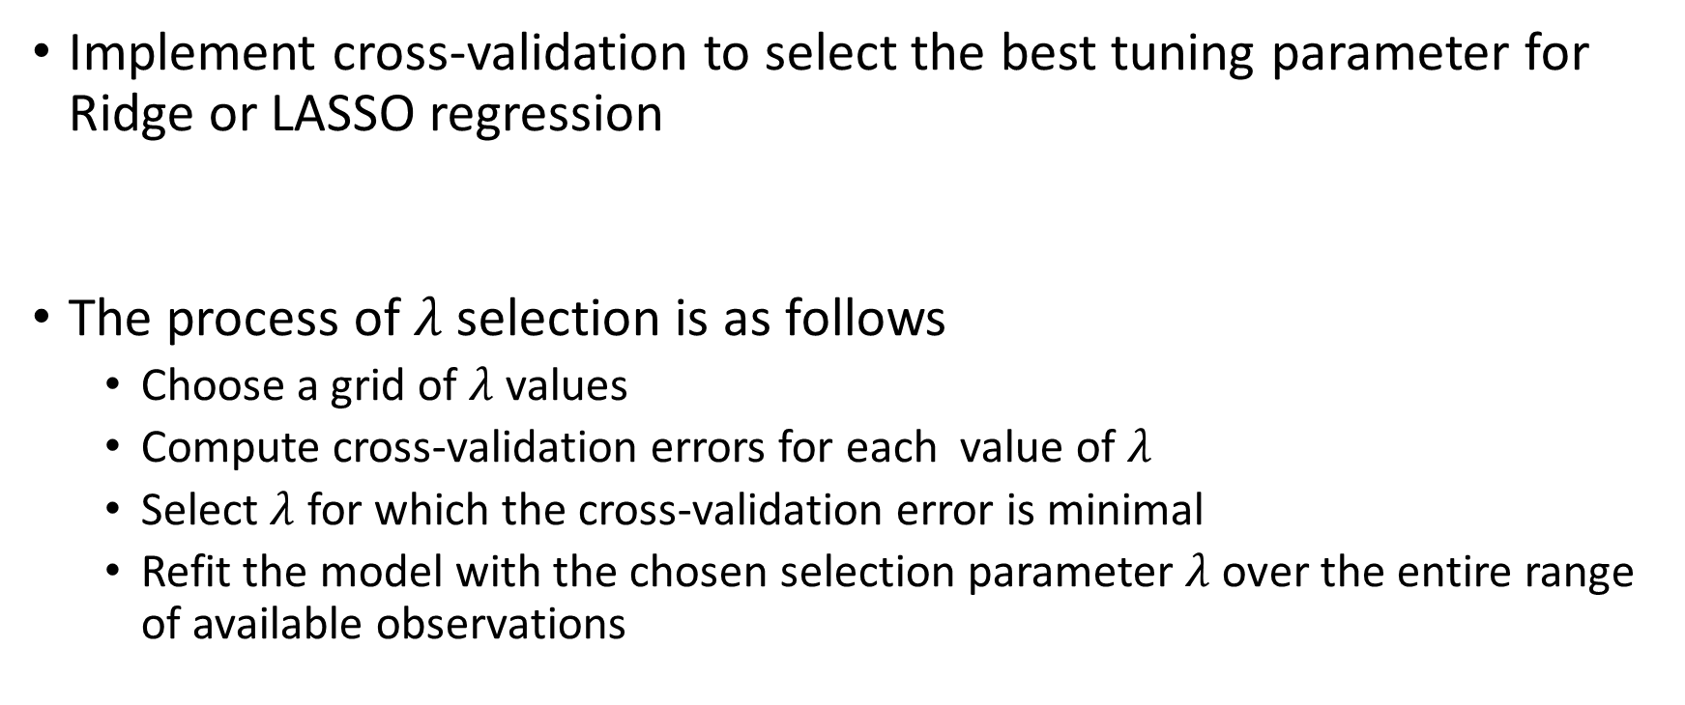

Selecting Tuning Parameter: $λ$
Implement cross-validation to select the best tuning parameter for Ridge or LASSO regression
The process of $λ$ selection is as follows
Choose a grid of $λ$ values
Compute cross-validation errors for each value of $λ$
Select $λ$ for which the cross-validation error is minimal
Refit the model with the chosen selection parameter $λ$over the entire range of available observations

Slide 36
Dimension Reduction Methods
Methods discussed so far have controlled variance in the dataset using two approaches:
Selecting a subset from the original variables
Shrinking variable coefficients to zero
The above methods are defined using the actual value of the predictors
Dimension reduction methods transform the predictors and then fit a Least Squares model to the transformed variables

Slide 37
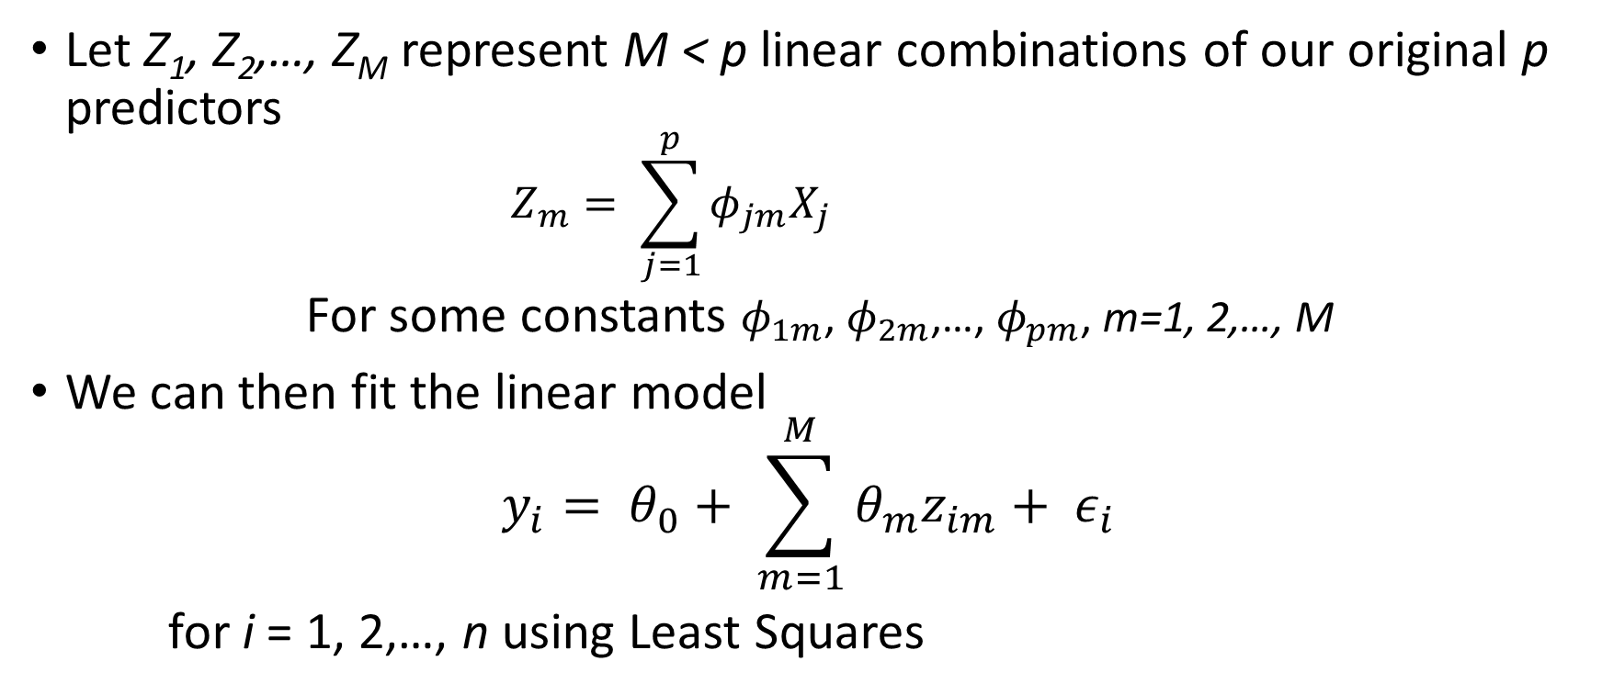
Linear Combination
Let Z₁, Z₂,…, Z_{M} represent M < p linear combinations of our original p predictors
$$Z_{m}= \sum_{j=1}^{p}{φ_{jm}X_{j}}$$
For some constants $φ_{1m}$, $φ_{2m}$,…, $φ_{pm}$, m=1, 2,…, M
We can then fit the linear model
$$y_{i}= θ_{0}+ \sum_{m=1}^{M}{θ_{m}z_{im}+ ε_{i}}$$
for i = 1, 2,…, n using Least Squares

Slide 38
Principal Component Analysis
PCA is a technique for reducing the dimension of a n*p data matrix X
The first principal component direction of the data is along which the observations vary the most
The number of principal components is less than or equal to the smaller of the number of original variables or the number of observations
This transformation is defined in such a way that the first principal component has the largest possible variance (that is, accounts for as much of the variability in the data as possible), and each succeeding component in turn has the highest variance possible under the constraint that it is orthogonal to the preceding components

Slide 39
Steps for PCA
Standardize: Standardize the scale of the data.
Calculate covariance: Compute the covariance matrix for the data.
Deduce Eigens: Compute the Eigen vectors that define the transformation of planes.
Re-orient data: Re-orient data to the reduced axes.
Plot re-oriented data: Plot the rotated data on the lower dimension space.
Complete bi-Plot: Plot the bi-plot to define
Axes: Principal Components
Points: Data points re-oriented to the new axes
Arrows: Arrows depicting the direction of increasing values for each variable

Slide 40
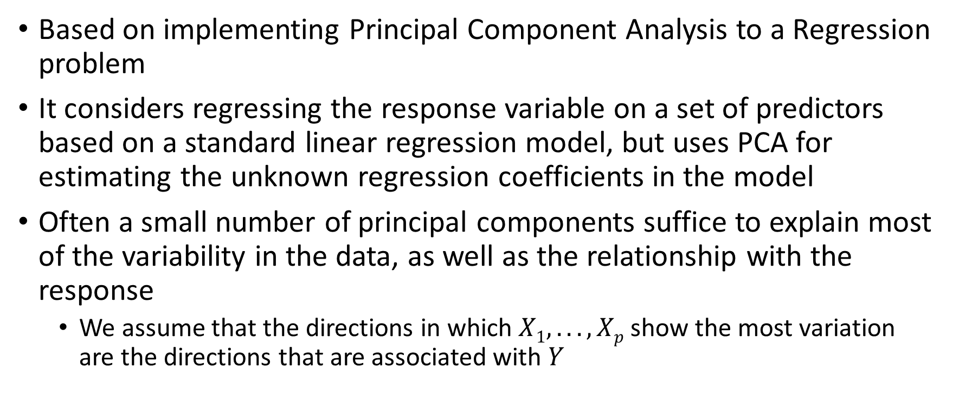
Principal Components Regression
Based on implementing Principal Component Analysis to a Regression problem
It considers regressing the response variable on a set of predictors based on a standard linear regression model, but uses PCA for estimating the unknown regression coefficients in the model
Often a small number of principal components suffice to explain most of the variability in the data, as well as the relationship with the response
We assume that the directions in which $X1, . . .,Xp$show the most variation are the directions that are associated with $Y$

Slide 41
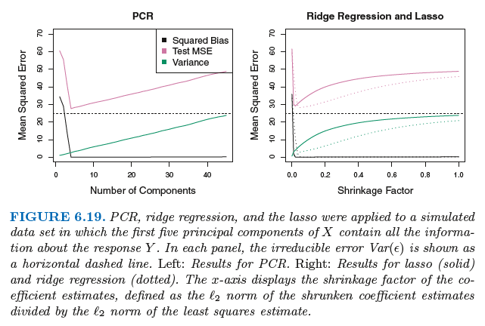

PCR involves constructing the first M principal components $Z1, Z2,…, ZM$ and then using these components as predictors in a linear regression model that is fit using Ordinary Least Squares

Slide 42
Partial Least Squares
PCR is an unsupervised way of dimension selection as it does not involve using the response variable to determine the predictors
PLS is a supervised alternative to PCR
Instead of finding hyperplanes of maximum variance between the response and independent variables, it finds a linear regression model by projecting the predicted variables and the observable variables to a new space

Slide 43
Latent Structures
Explain correlation between observed variables and hidden causes of those variables
These variables induce some assumptions on the actual data
Latent Structures attempt to find directions that help explain both the response and the predictors
Latent Structures determine the covariance structures for the response and a predictorm

Slide 44
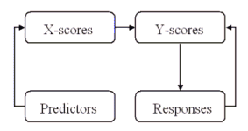

Slide 45
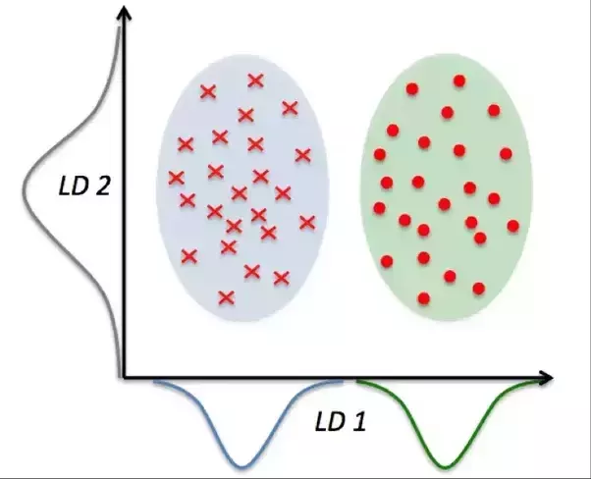
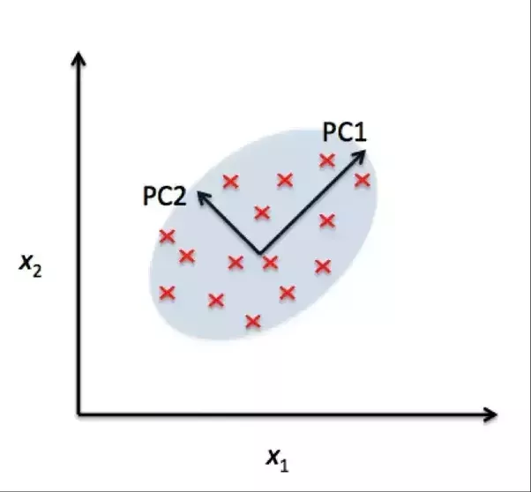
Linear Discriminant Analysis
Used to find a linear combination of features that characterizes or separates two or more classes of objects
Explicitly attempts to model the differences between classes of data
LDA is a supervised technique

Slide 46
Higher Dimensional Data
Data sets containing more features than observations are often referred to as high-dimensional.
Classical approaches are not suitable for such settings
As dimensionality increases, there is an increased danger of over-fitting
Possibility of high bias rising due to the number of predictors for a single row of data

Slide 47
What Goes Wrong
For higher dimensions, on applying a simple Linear Regression model:
regardless of whether or not there truly is a relationship between the features and the response, least squares will yield a set of coefficient estimates that result in a perfect fit to the data, such that the residuals are zero
predicts relationships even when the variables are completely unrelated
increases error rates and the metric values become useless in selecting a model

Slide 48
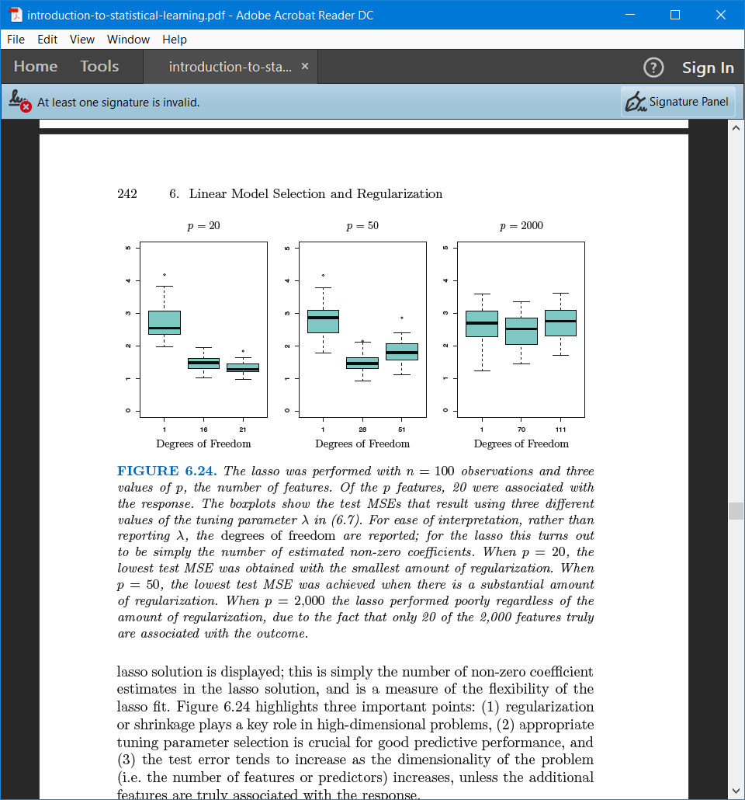
Regression in Higher Dimensions

